Slide 1
Machine Learning Methods
Splitting Data into Training and Test Datasets
Cross-Validating Models for each Variable Combination
Selecting Most Parsimonious Model with Lowest Test Error
ML
Stage I
Run Tuned Model on Entire Dataset and Analyze Results
Tuning Selected Model
ML
Stage II
Apply SHAP Values to Dissect Predictive Power
Use SHAP Values to Analyze Variable Behavior

Slide 2
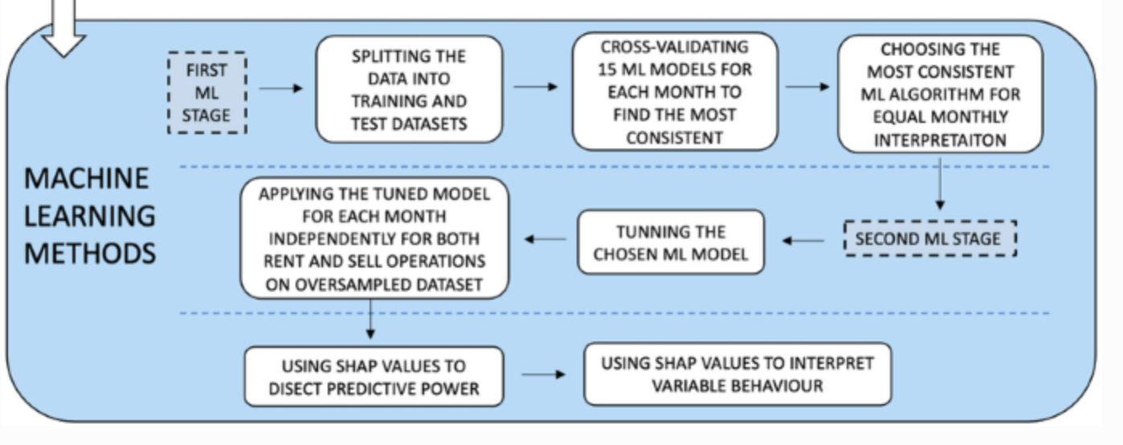

Slide 3
Validation Set Approach
Total Data Set
1, 2, 3, 4, 5, …
n
Train Data Set (80%)
Test Data Set (20%)
1, 37, 77, 2, 45, …
39, 3, 92, 13, 5, …

Slide 4
K-Fold Cross Validation
(k = 4)
Total Data Set
1, 2, 3, 4, 5, …
n
Test Data Set (25%)
1, 37, 77, …
92, 13, 5, …
1, 37, 77, …
92, 13, 5, …
1, 37, 77, …
92, 13, 5, …
1, 37, 77, …
92, 13, 5, …

Slide 5
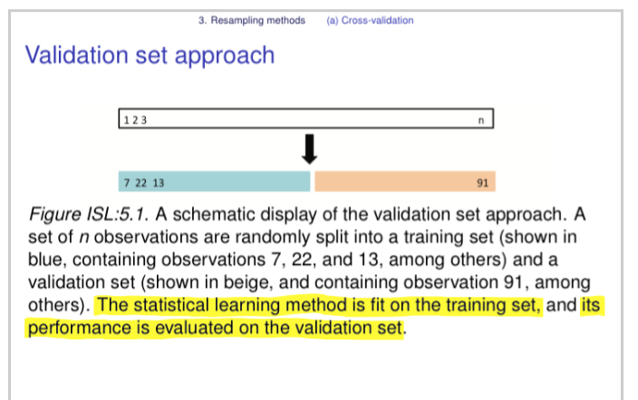
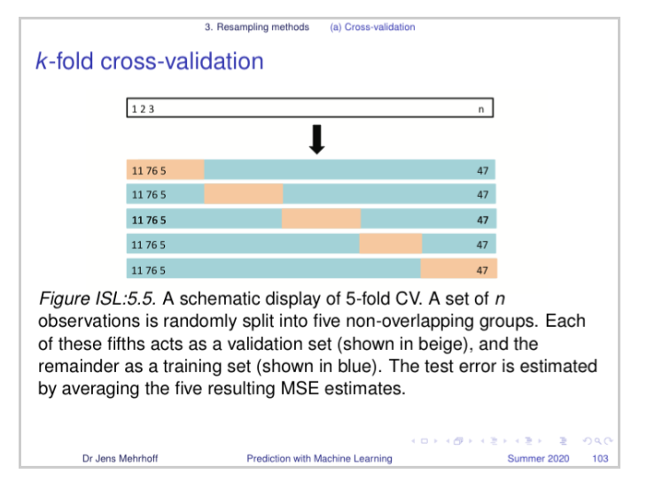

Slide 6
Unique Identifier | beds_total
#112345 | beds_total_1
#22346 | beds_total_2
#31452 | beds_total_3
#49083 | beds_total_4
#59867 | beds_total_5
Unique Identifier | beds_total_1 | beds_total_2 | beds_total_3 | beds_total_4 | beds_total_5
#112345 | 1 | 0 | 0 | 0 | 0
#22346 | 0 | 1 | 0 | 0 | 0
#31452 | 0 | 0 | 1 | 0 | 0
#49083 | 0 | 0 | 0 | 1 | 0
#59867 | 0 | 0 | 0 | 0 | 1
One-Hot Encoding

Slide 7
Results Structure
Key Variable Analysis
Number of Bedrooms
Days on the Market
Land Size
Corona Crisis
Property Style
Corona Crisis
City Limits vs Not
Price: Q1 vs Q4
Size: Q1 vs Q4
Age: Q1 vs Q4

Slide 8
Subsection Analysis
Corona Crisis
City Limits vs Not
Price: Q1 vs Q4
Size: Q1 vs Q4
Age: Q1 vs Q4
Key Variable Analysis
Number of Bedrooms
Days on the Market
Land Size
Property Style

